Slide 1


VED POC : Overview
Company confidential

Slide 2
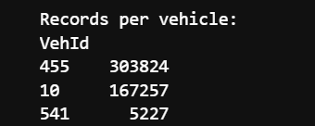
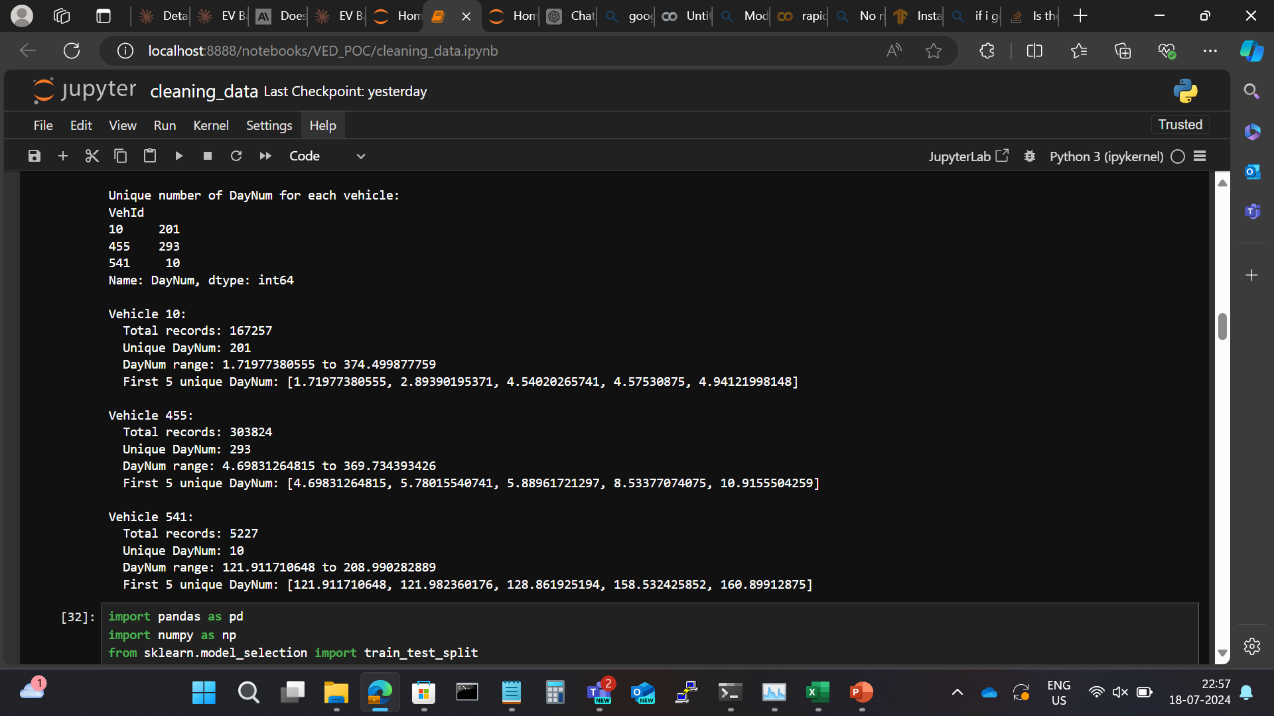
Analysis of the given open source data
The given dataset has only 3 EV
The VehId (Vehicle ID) are:
10
455
541
VehId 10 contains:
VehId 455 contains:
VehId 541 contains:
The Vehicle ID 541 contains data of only 10 days.

Slide 3
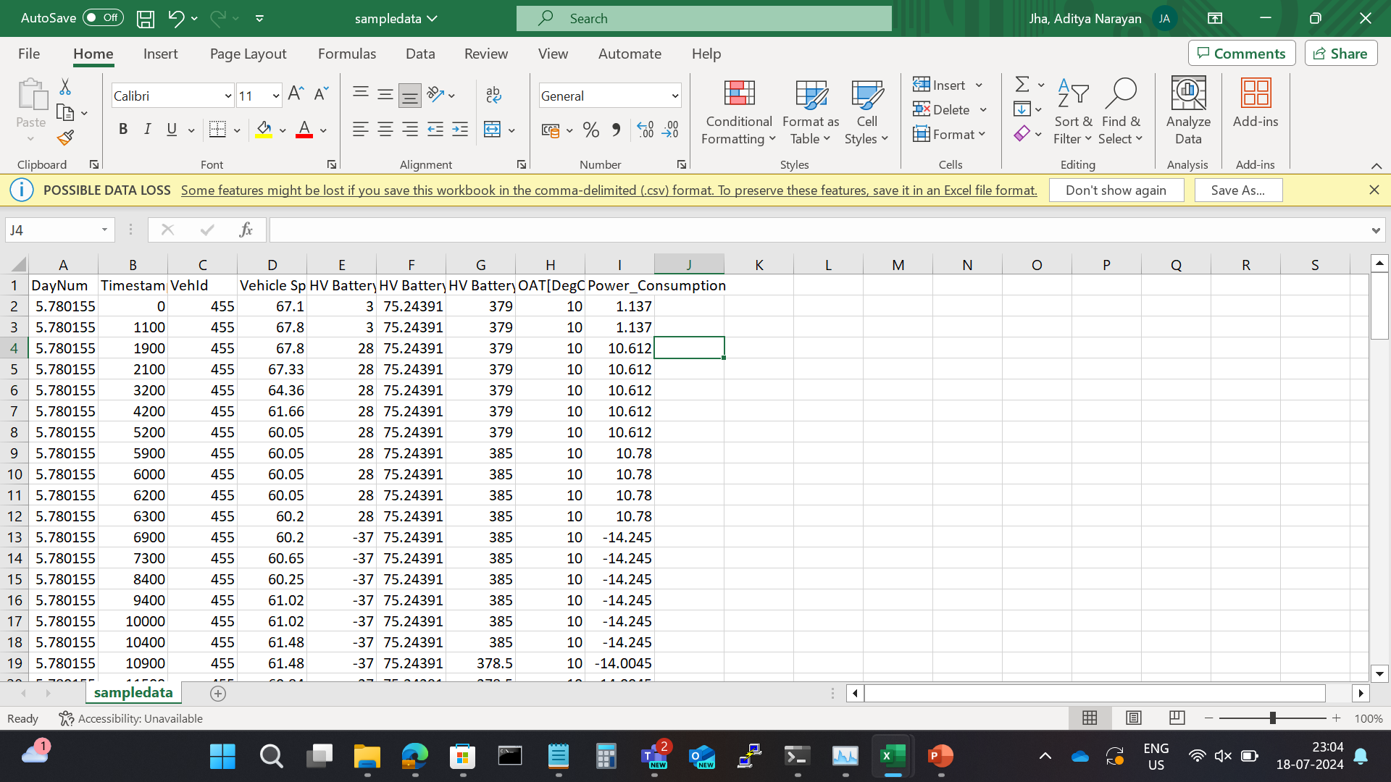
Irregularities in data
The Timestamp of the recorded data from the cars are not at regular intervals
The timestamp starts from 0 and goes to 1100
Then it only increments by 800
Over here it only increments by 200

Slide 4
Implemented Random Forest to predict the Future Battery Trend

Slide 5
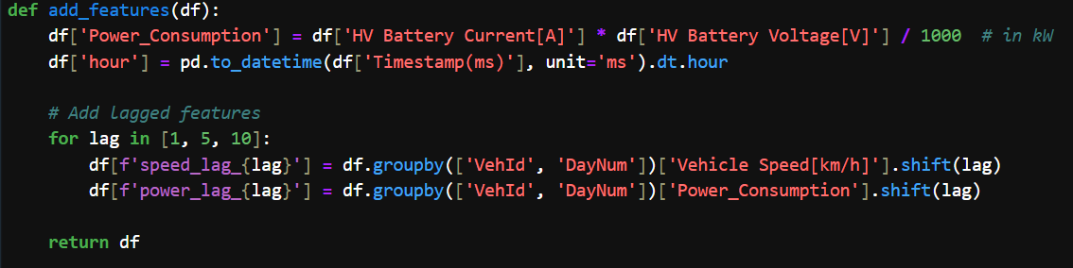
Added Features
Lag:
Lag features are past values of a variable used to predict future values
They capture recent historical patterns in the data
In this model, lag features are created for vehicle speed and power consumption
The code creates lag features for 1, 5, and 10 time steps back
It uses pandas' shift() function to offset the data
The groupby ensures lags are calculated separately for each vehicle and day

Slide 6
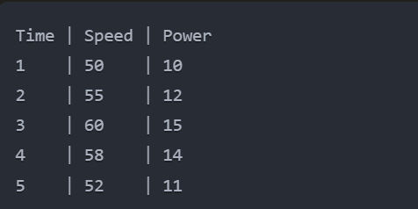
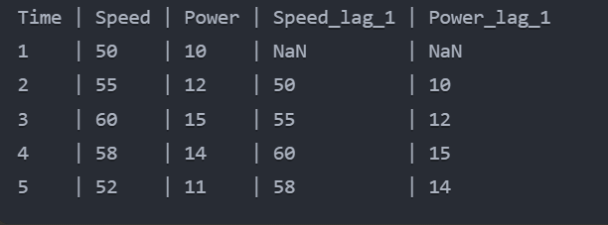
Example of lag feature creation: Original data
After creating lag_1 features

Slide 7
Handling of lag features:
The first few rows will have NaN values for lag features
These rows are typically dropped or filled with a default value before model training
Benefits of multiple lag periods:
lag_1: Captures immediate past state
lag_5: Captures short-term trends
lag_10: Captures slightly longer-term patterns

Slide 8
Other Features added
Power_Consumption: Calculated to represent energy usage
hour: Extracted to capture time-of-day patterns
Why these features?
Power_Consumption: Direct impact on battery drain
hour: Captures daily usage patterns
Lagged features: Provide short-term historical context for predictions

Slide 9
Data Splitting
Train set (70%): Used to train the model
Validation set (10%): Used to tune hyperparameters and prevent overfitting
Test set (20%): Used for final evaluation of model performance
Importance of this split:
Prevents data leakage
Ensures model generalizability
Provides unbiased evaluation of final model performance

Slide 10
Model Selection - Random Forest
Advantages of Random Forest for this problem:
Handles non-linear relationships well
Can capture complex interactions between features
Robust to outliers
Provides feature importance, helping understand key factors in prediction.

Slide 11
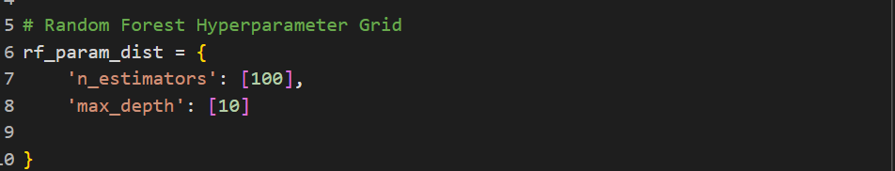
Model Parameters

Slide 12
Model Evaluation

Slide 13
Model Predictions

